Slide 1
Half-Precision FMAC

Slide 2
Feature
A 3-stage Half-precision fused-multiply-accumulate(FMAC)
Optimized for low area
Targeting 1 GHz at TSMC 28nm HPC+ 9T 30P140 -40C (tcbn28hpcplusbwp30p140ssg0p81vm40c)
Only support vector single width add/sub/mul/fma instructions

Slide 3
Abbreviation
NaN: not a number
Inf: infinity
fracA/fracB/fracC: significant of operand 1/2/3
expA/expB/expC: exponent of operand 1/2/3

Slide 4
Interface - Input
input | Bit width | Description
core_clk | 1 | clock signal
core_reset_n | 1 | reset signal, active low
f1_valid | 1 | valid input
f1_round_mode | 3 | rounding mode 0: Round to Nearest, ties to Even (RNE) 1: Round towards Zero (RTZ) 2: Round Down (RDN) 3: Round Up (RUP) 4: Round to Nearest, tie to Max Magnitude (RMM)
f1_ex_ctrl | 5 | operations
f1_op1/2/3 | 16 | operands 1/2/3: op1 * op2 + op3

Slide 5
Interface - Output
output | Bit width | Description
f3_wdata_en | 1 | valid output
f3_wdata | 16 | output data of operation
f3_flag_set | 5 | exceptions {invalid, divide-by-zero, underflow, overflow, inexact}

Slide 6
Ex ctrl encoding
Operator | ex_ctrl Encoding
VFADD | 5'b00000
VFWADD | 5'b11110
VFSUB | 5'b00001
VFSUBVF | 5'b00110
VFWSUB | 5'b11111
VFMUL | 5'b00010
VFMACC | 5'b11000
VFMSAC | 5'b11001
VFNMACC | 5'b11010
VFNMSAC | 5'b11011
VFMADD | 5'b10000
VFNMADD | 5'b10001
VFMSUB | 5'b10010
VFNMSUB | 5'b10011
VFPMADT | 5'b11100
VFPMADB | 5'b11101

Slide 7
Fused-MAC
Fused multiply-add performs floating-point multiply-add in one step, with a single rounding
The multiplier multiplies op1 with op2, called the Product, then
Add with the op3, called the Accumulator
In this spec, the op1/2/3 is mapped to opA/B/C
Typically, a fused-mac consists following components
Multiplier: calculate the product of two operands
Aligner: align the accumulator and the product
alignment sticky: it’s impractical to record all bits during alignment, bits shifted-out of effective significant digits are merged into one alignment sticky bit
Adder: sum the accumulator and the product
Normalizer: normalize the added sum
Leading-zero anticipator: to get the normalization shift amount ahead of the addition by analyze the addend bit patterns
Rounding Unit
Generate rounding digits for bounding the result to IEEE 754 format

Slide 8
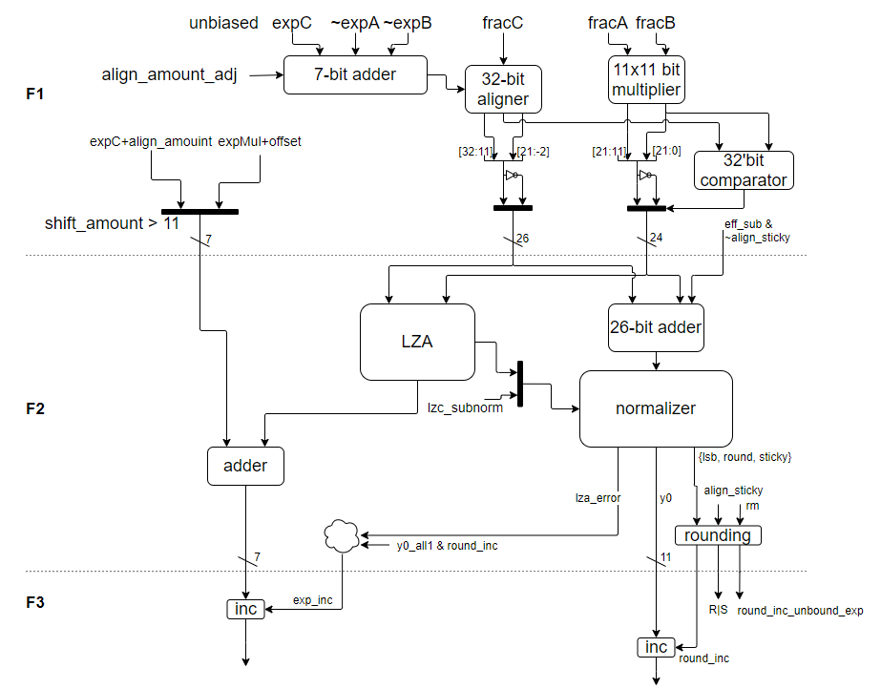
Micro-Architecture – V1

Slide 9
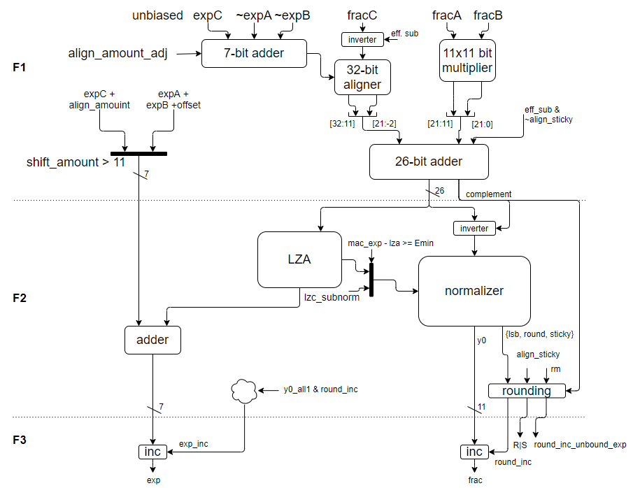
Micro-Architecture – V2

Slide 10
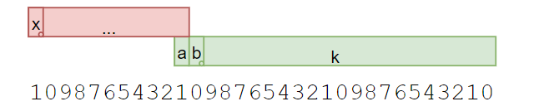

Alignment (1/)
Align amount
For simplicity, the accumulator only do right shift, the accumulator is placed with 11 digits offset to the product
align amount = expA + expB - expC + (-bias + offset)
use 4:2 CSA to compress the four operands into two operands, don’t expect compiler optimization
bit width = 5 + 2, since the amount is range from -35 ~ 58

Slide 11
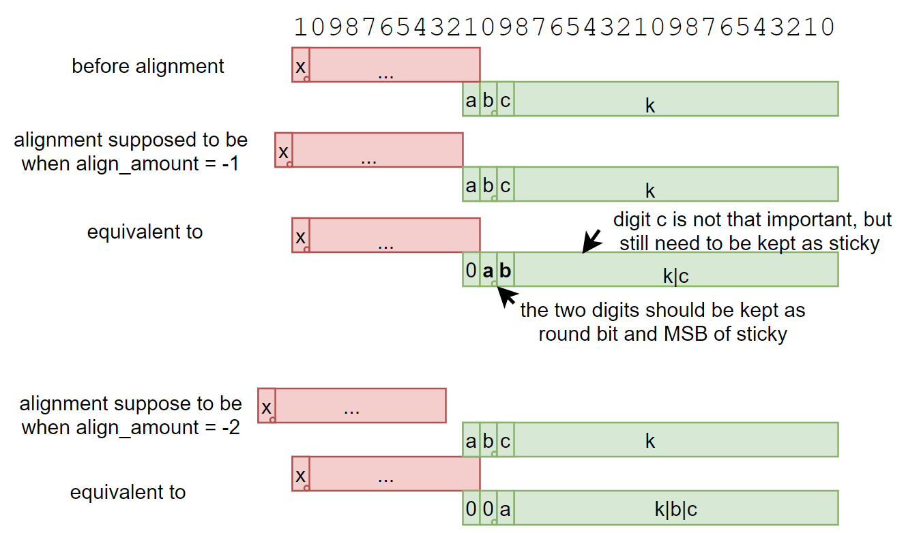
Alignment (2/)
In order to do the alignment with a 5-level barrel shifter

Slide 12
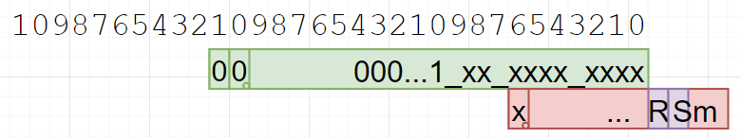
Alignment (3/)
Additional bits beyond the … needs to be kept when one of the multiplicand is a subnormal

Slide 13
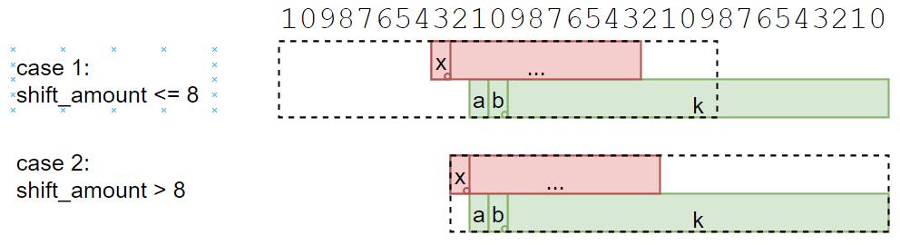
Alignment (4/)
To reduce the pipe register and adder width, the accumulator and the product is cut from 32-bit to 23-bit according to the alignment
note that (shift_amount = 9) must not take as case 1, since the sum might be 0.00…01, the whole K should preserved as effective digits after normalization

Slide 14
Alignment (5/)
Alignment sticky for rounding
case 1: use cut-off product bits
case 2: use accumulator bit shifted beyond 32
Alignment sticky for MAC sum
the eff. sub and no sticky is purely for complete the 2’s complement form
only the accumulator sticky involved in the logic

Slide 15
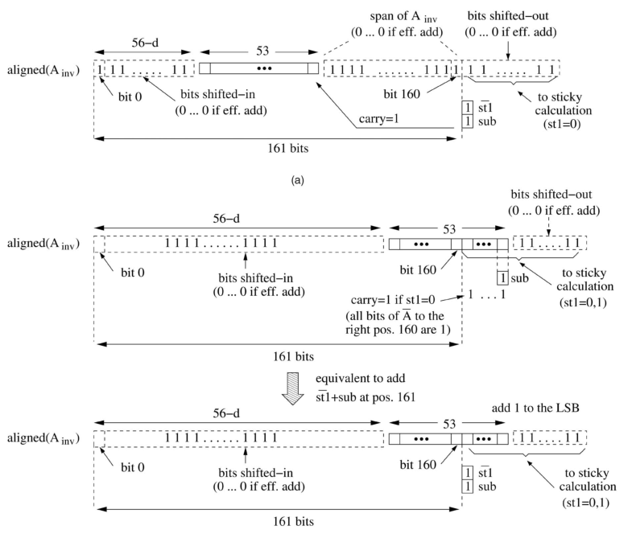
The +1 for 2’s Complement After Alignment
When the operation is effective subtraction (a*b-c or -a*b+c), the accumulator should be inverted and +1
The +1 adds extra logic delay before the product and accumulation sum logic
The figure shows how to move the +1 to after the alignment, thus it can be add into the product and accumulation sum logic
please note the figure is to illustrate in Double Precision format, but the concept is the same

Slide 16
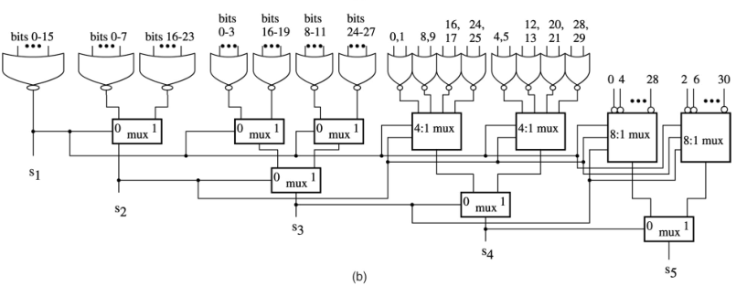
LZA
Use structuralized LZA
Or network has bigger area but shorter latency
LZA error
timing is ok, an additional 1-bit shifter is add after the normalization shifter
With V2 uArch, there is no LZA error

Slide 17
Why we add a HA before the LZA
We want to keep the exponent +1 logic….
When use simple (^b_{i})&(|b_{i-1}) LZA
The result will be wrong when LZA error and exponent increment caused by rounding occurs at the same time
With V2 uArch, this issue is no longer exist

Slide 18
The Lost +1 When the MAC Sum is Negative (1/)
To complete the 2’s complement form of…
The +1 isn’t added before rounding, it is combined into the rounding increment logic
MAC sum is negative => complement = 1
Observation:
the +1 is only effective when the round-off bits are all-ones => normalization should shift with complement instead of zeros
when the round-off bits are all-one and complement = 1 => the REAL round-off bits (after the +1) will be all 0, thus no longer round increment => the result +1 cause by complement and rounding increment is exclusive => the complement +1 event can be add into the original round increment logic

Slide 19
The Lost +1 When the MAC Sum is Negative (2/)
Rounding bits calculation
sticky_msb_inc = sticky_bits_except_msb_all_one & ~align_sticky & complement
{L’, R’, Sm’} = {L, R, Sm} + {2’b0, sticky_msb_inc}
L => LSB of fraction
R => rounding bit
Sm => MSB of sticky bits
Round increment
original rounding increment, or
complement +1 propagated to the LSB
This technique might not be practical since the complement signal needs to be ready before normalization

Slide 20
Exceptions – Invalid Operation
Any general-computational or signaling-computational operation on a signaling NaN
Multiplication: multiplication(0, ∞) or multiplication(∞, 0)
IEEE 754: fusedMultiplyAdd(0, ∞, c) or fusedMultiplyAdd(∞, 0, c) unless c is a quiet NaN; if c is a quiet NaN then it is implementation defined whether the invalid operation exception is signaled
RISC-V spec: must set flag even when the addend is a quiet NaN
Addition or subtraction or fusedMultiplyAdd: magnitude subtraction of infinities, such as: addition(+∞, −∞)

Slide 21
Exceptions – Overflow
If the destination format’s largest finite number is exceeded in magnitude by what would have been the rounded floating-point result
Detection
Compare before rounding for speed
Compare the unbounded exponent and unbounded exponent + 1 together, then select after the rounding result comes out
Bounded value when Overflow exceptions occurs
see special value: infinity, special value: largest value

Slide 22
Exceptions – Underflow (1/)
IEEE 754 definition:
Signaled when a tiny non-zero result is detected
Tininess may detected as
Before rounding - when a nonzero result computed as though both the exponent range and the precision were unbounded would lie strictly between ± 2^{Emin}
After rounding - when a nonzero result computed as though the exponent range were unbounded would lie strictly between ± 2^{Emin}
RISC-V definition:
Tininess is detected after rounding

Slide 23
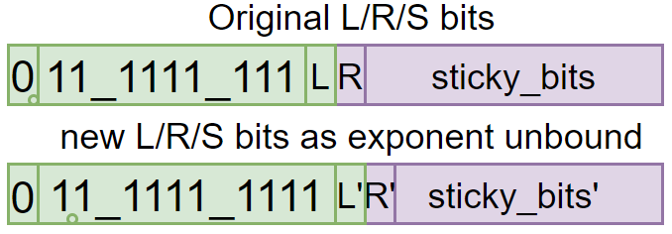
Exceptions – Underflow (2/)
Detection:
Condition 1: the result is between ±2^{Emin} and doesn’t rounded to a normal value
hidden one before rounding is 0, and
without round increment or fraction is not all 1
Condition 2: the result is between ±2^{Emin} , but rounded to a normal value; however, the result will still between ±2^{Emin} if rounded as the exponent is unbounded
hidden one before rounding is 0, and
with round increment, and fraction is all 1, and
~(L’ & ((ri & (R’|stick_bits’)) | (rne & R’ & (L’|sticky_bits’)) | (rmm & R’))
=> ~(L’ & (ri & (R’|sticky_bits’) | (rne & R’) | (rmm & R’))
ri: round to ± inf
rne: round to nearest even
rmm: round to nearest max magnitude

Slide 24
Exceptions – Inexact
Signaled when the rounded result of an operation is inexact
it differs from what would have been computed were both exponent range and precision unbounded
Detection
non zero round bit or sticky bit, or
overflow

Slide 25
Special Value – Zero (1/)
Zero (0x0000/0x8000)
0 +/- 0
detect in the 1st stage
Sign
(+0) + (+0) => +0
(+0) + (-0) => RDN: -0, others: +0
(-0) + (-0) => -0
Result is exactly zero
detected after the product is added to accumulator (in the f2 stage)
the result is -0 if round to -inf

Slide 26
Special Value – NaN (2/)
NaN (0x7e00)
Detect in 1st stage
Cases
One of the operand is a NaN
(+Inf) + (-Inf)
Inf * 0
Set invalid exception if one of the operand is a signaling NaN

Slide 27
Special Value – Infinity (3/)
Infinity (0x7c00/0xfc00)
Detect in 1st stage
One of the operand is an Inf, none is NaN
for the product, if one operand is an Inf, the other one shouldn’t be zero
if both of the product/accumulator is an Inf, their sign should be the same
Detected in last stage
overflow exception occurs and,
round mode is RNE/RMM/RUP w. positive result/RDN w. negative result

Slide 28
Special Value – Smallest Value (4/)
Non-zero smallest value (0x0001/0x8001)
Detected in last stage
result is not zero, smaller than the smallest subnormal and,
unbounded result exponent < Emin
rounding mode is RUP w. positive result/RDN w. negative result
Could be reduce to normal arithmetic path?? => yes, verified

Slide 29
Special Value – Largest Value(5/)
Non-infinity largest value (0x7bff/0xfbff)
Detect in last stage
overflow exception occurs and,
rounding mode is RDN w. positive result/RUP w. negative result

Slide 30
Pending Work
eff. sub might on the critical path: optimize instruction encoding

